Slide 1
Templates

Slide 2
Objectives
In this chapter, you will
  Learn about templates
  Explore how to construct function templates and class templates
C++ Programming: From Problem Analysis to Program Design, Seventh Edition

Slide 3

Templates
Template: a single code body for a set of related functions (function template) and related classes (class template)
Syntax:
  Type is the data type
  Declaration is either a function declaration or a class declaration
C++ Programming: From Problem Analysis to Program Design, Seventh Edition

Slide 4
Templates (cont’d.)
class in the heading refers to any user-defined type or built-in type
Type: a formal parameter to the template
Just as variables are parameters to functions, data types are parameters to templates
C++ Programming: From Problem Analysis to Program Design, Seventh Edition

Slide 5

Function Templates
Syntax of the function template:
Type is a formal parameter of the template used to:
  Specify type of parameters to the function
  Specify return type of the function
  Declare variables within the function
C++ Programming: From Problem Analysis to Program Design, Seventh Edition

Slide 6
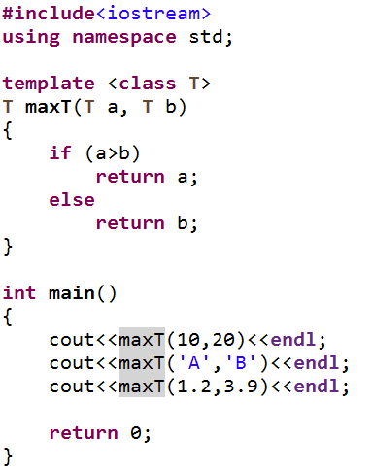

Function Templates-Example
OUTPUT
C++ Programming: From Problem Analysis to Program Design, Seventh Edition

Slide 7

Class Templates
Class template: a single code segment for a set of related classes
  Called parameterized types
Syntax:
A template instantiation can be created with either a built-in or user-defined type
The function members of a class template are considered to be function templates
C++ Programming: From Problem Analysis to Program Design, Seventh Edition

Slide 8
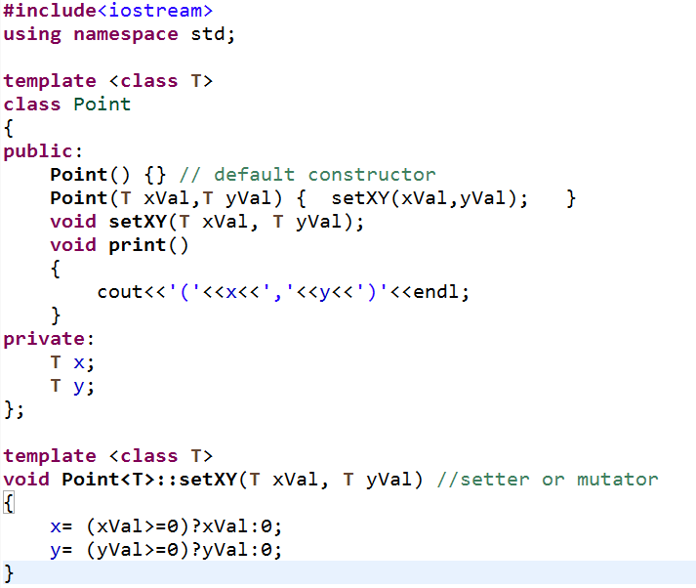
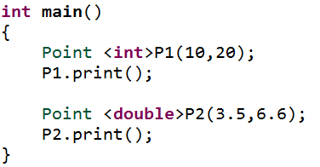

Class Templates-Example
OUTPUT
C++ Programming: From Problem Analysis to Program Design, Seventh Edition

